Slide 1
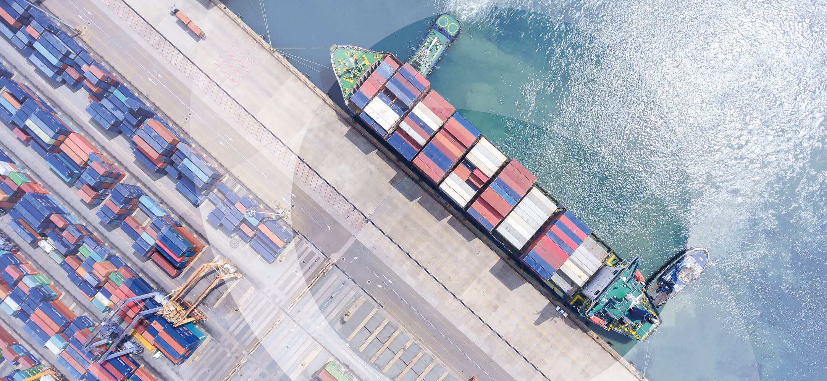
VDES – the next generation of AIS
WFSA Ferry Safety & Technology Conference, June 2020
David Hewson and Dr. Noah Smith

Slide 2
Overview
1 | Maritime industry background
 | Current challenges and opportunities
2 | AIS (Automatic Identification System)
 | How it started, later developments and growing issue of spectrum congestion
3 | VDES (VHF Data Exchange System)
 | How the system works, how it addresses issues with AIS and rollout timeline
4 | New applications that are possible with VDES
 | Benefits for weather reporting, navigation, Search and Rescue, Vessel Traffic Services and port logistics
5 | Sea Traffic Management – an example of what is possible with VDES
 | EU-funded project in the Baltic Sea provides a glimpse of the future
6 | Outlook on terrestrial vs. satellite VDES
 | Dramatic changes in the satellite industry create uncertainty
7 | Vesseltracker / Wood Mackenzie strategy
 | New internal customers give us a strong business case for VDES investment

Slide 3
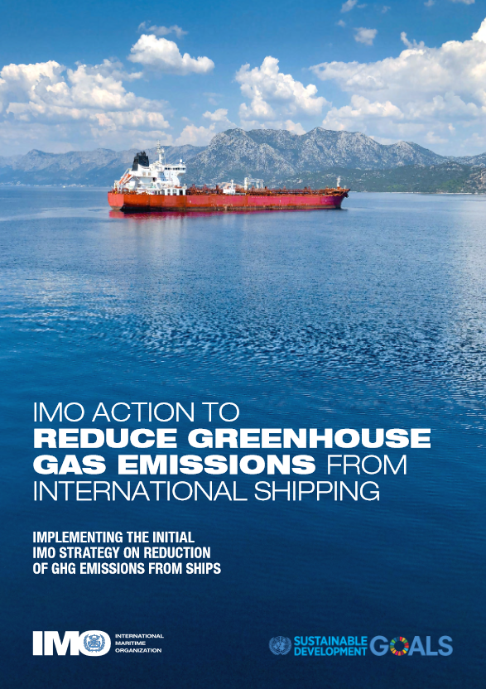
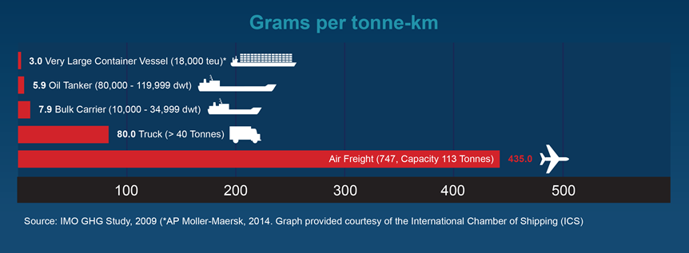
The maritime industry is under pressure to improve its environmental record
But the global focus on reducing emissions also provides a unique growth opportunity
The maritime industry faces growing pressure to reduce its greenhouse gas emissions and protect the environment
But its relative carbon efficiency also makes shipping an attractive choice to displace other forms of transportation
For example: low-emission ferries could displace high-emission flights in many European markets
Can we reduce emissions while accommodating more maritime traffic - safely?

Slide 4
Current barriers to a safe, clean and efficient future
Siloed information and barriers to collaboration have consequences
Information gap | Consequences
Vessel routes unknown by other vessels | Increased risk of collision Inefficient routing eg. Baltic Sea ferries forced to wait their turn to cross narrow passages
Vessel routes unknown by shore-based authorities | Authorities can‘t support routing decisions based on weather, congestion or local knowledge Reduced safety and increased delays
Port and hinterland actors unware of vessel delays | Inefficient resource deployment For example: port operators hold slots for vessels that can‘t make schedule
Vessels don‘t know current port congestion status | Inefficient routing eg. speeding up to make schedule, then waiting in anchorage (i.e. Rush to Wait)

Slide 5
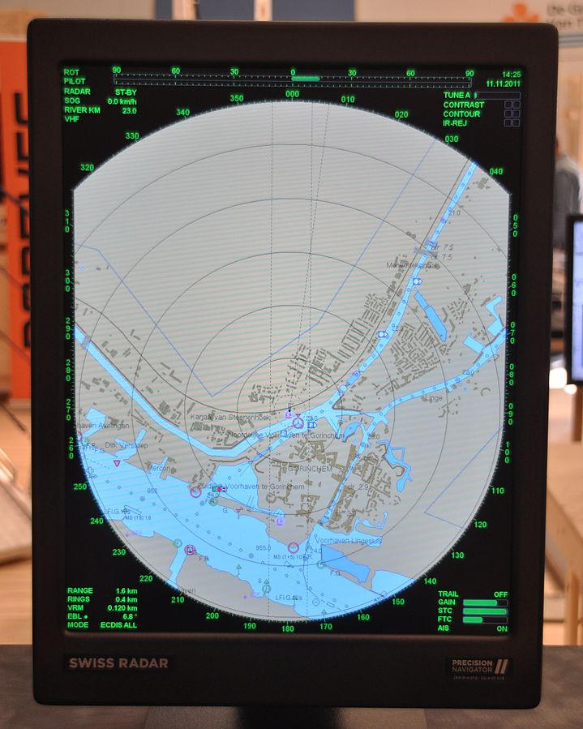
AIS has become an important information-sharing tool
Its widespread use has helped to digitize the maritime industry
The IMO mandate for the Automatic Identification System in 2002 has resulted in near-universal use. AIS transceivers are now installed on 200k+ vessels, base stations and Aids to Navigation
AIS is a major aid in avoiding collisions. Seafarers can view AIS and radar overlaid on ECDIS displays and hail nearby vessels by name to clarify intentions and alter course
The global maritime industry, hungry for information, has also used AIS for many new and unintended applications
Examples:
  destination port shows where vessels are planning to go
  historical track shows where they have been

Slide 6
But AIS is also becoming a victim of its own success
Wide adoption and new applications have caused AIS spectrum congestion
Since all commercial vessels were already using AIS, smaller vessels eg. pleasure craft voluntarily started to do so, too
Application-Specific Messages (ASMs) standardized in 2010, allow transmission of small informational text messages eg. water levels in canals, weather data
Consequences
Spectrum congestion, especially in dense traffic locations eg. Singapore
Growing interest in using AIS ASMs for even more new purposes
AIS slot spectrum

Slide 7
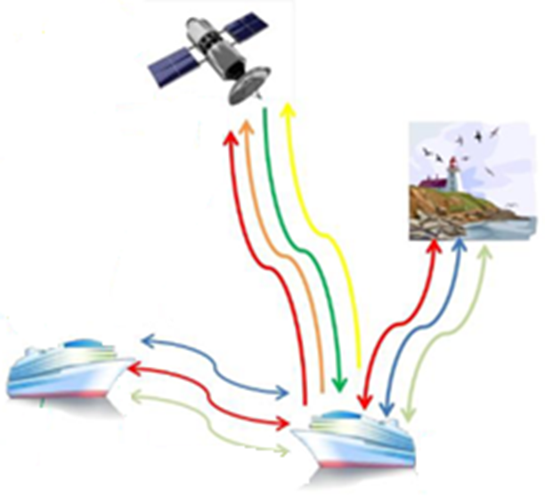
The solution: VHF Data Exchange System (VDES)
Designed to complement – not replace – existing AIS
New information-sharing channels will free up existing AIS spectrum, ensuring that it remains effective for its original purpose: collision avoidance
3 main components of VDES:
Existing AIS
New Application Specific Messages (ASMs) for local information sharing
Satellite links – both up and down

Slide 8
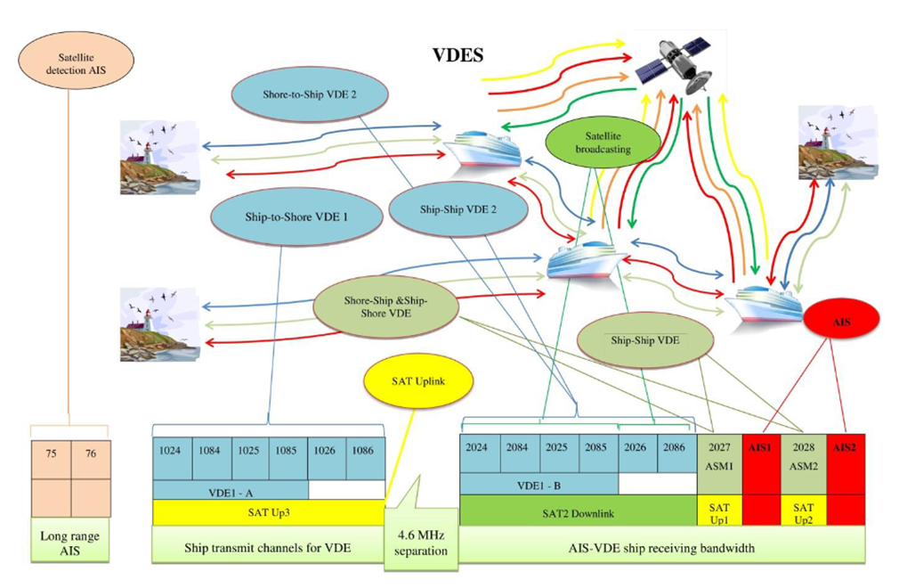
Summary of VDES improvements vs. existing AIS
Up to 32x more bandwidth vs. existing AIS
Satellite to ship communications worldwide
Improved authentication eg. header informs number of bytes in following message
Other improved cyber security and integrity features eg. key management, encryption

Slide 9
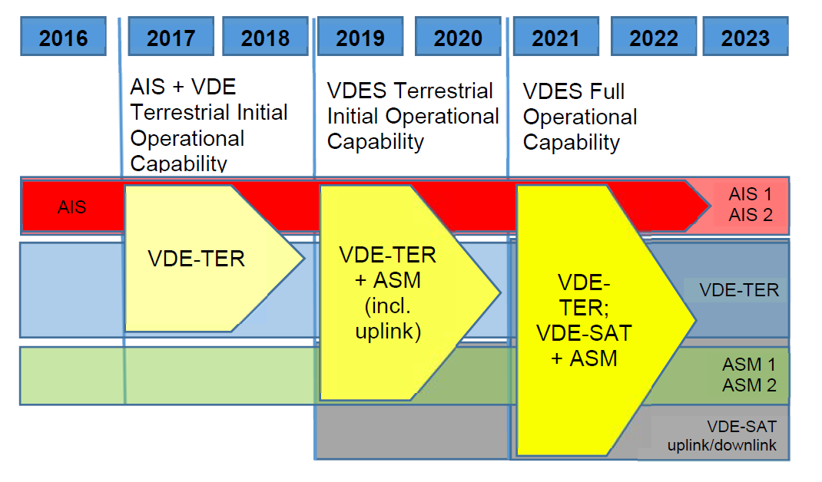
VDES rollout timeline
Data is already out there!
As with AIS:
  Development is spurred by IALA*
  Spectrum approved by ITU**
Unlike AIS, no sign of IMO mandate – yet
Plenty of bandwidth set aside for as-yet unknown applications
Easy upgrade for vessels. Existing AIS antenna and connections can be re-used, only the transceiver needs to be replaced
*International Association of Marine Aids to Navigation and Lighthouse Authorities. **International Telecommunication Union.

Slide 10
Exciting applications that are possible with VDES
Weather – ships can provide local temperature/pressure, wave height, current ice conditions, which will also aid current World Meteorological Organization‘s (WMO) Voluntary Observing Ships scheme. Shore facilities can broadcast sudden changes/warnings to vessels in the affected area.
Navigational dangers – derelicts, missing buoys and other new dangers can be reported and broadcasted.
Search and Rescue – nearby vessels can broadcast latest information to help SAR operations. SAR coordinator can broadcast information on resources, plan, waypoints for search pattern, and updates on execution of operation.
Vessel traffic services – vessels can submit routes and receive suggested updates from shore. VTS coordinators can organize traffic to prevent dangerous situations from occurring and provide navigational assistance.
Port logistics / hinterland actors – terminal operators, tugboats, pilots, agents, etc can receive updated vessel ETAs as routes and conditions evolve.

Slide 11
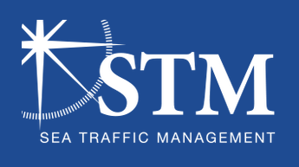

Sea Traffic Management provides a glimpse of the future
EU-financed e-Navigation project is centered in the Baltic Sea region
Goal:
Provide all stakeholders in the maritime supply chain with a platform where everybody has the same situational overview.
Achievements:
Data standards created for voyage plans and port timestamps
ECDIS interface, integration and day-to-day VTS operations proven to work
73% of seafarers report feeling safer when using enhanced monitoring from shore
Validated so far by:
250+ merchant vessels
6 VTS centers
9 ports
13 simulation centers

Slide 12
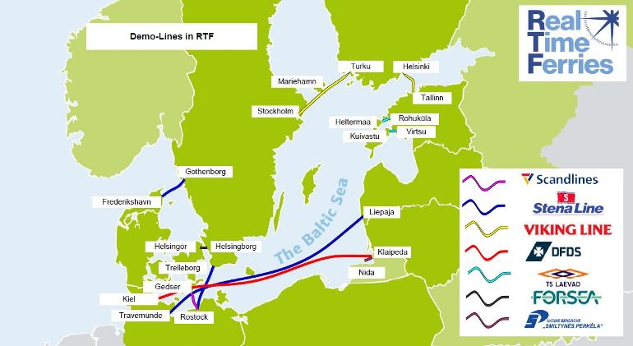
Real Time Ferries – STM’s ferry-specific project
Real-time information allow passengers and logistics ecosystem to adjust plans on-the-fly
Learn more: RTF website and Demo video

Slide 13
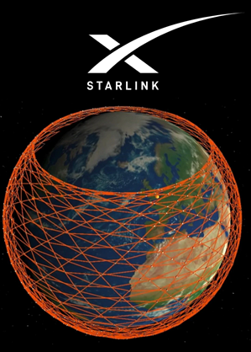
A big unknown: the role of terrestrial vs. satellite VDES
Dramatic changes in the satellite industry create uncertainty
SpaceX and others are aggressively deploying satellite Internet connectivity, and launch costs throughout the satellite industry are falling.
What effect will this have on terrestrial VDES?
We believe terrestrial VDES will still play a key role:
Many VDES applications eg. ship-ship, ship-local VTS are only relevant locally, favouring line-of-sight radio vs. roundabout satellite routing
New awareness about risks of over-relying on satellites eg. GPS – jamming, spoofing have led to investment $$$ in next-gen automated stellar navigation
Satellite orbits are getting crowded – the coming years will be instructive

Slide 14
We have a strong business case for VDES investment
Verisk / Wood Mackenzie acquisition gives us excellent internal customers
Data analytics and risk assessment in:
Insurance, natural resources, financial services, government
Long-term forecasts and consulting in:
Oil, gas, refining, chemicals, power & renewables, metals & mining, corporate analysis, electric vehicles
Real-time monitoring and short-term forecasts in:
Oil, gas, agriculture/biofuels, power and maritime shipping
Vesseltracker.com
Real-time AIS services for maritime professionals
Acquired Nov 2019
Light blue text shows industries where Vesseltracker maritime AIS data could be integrated, or already is

Slide 15
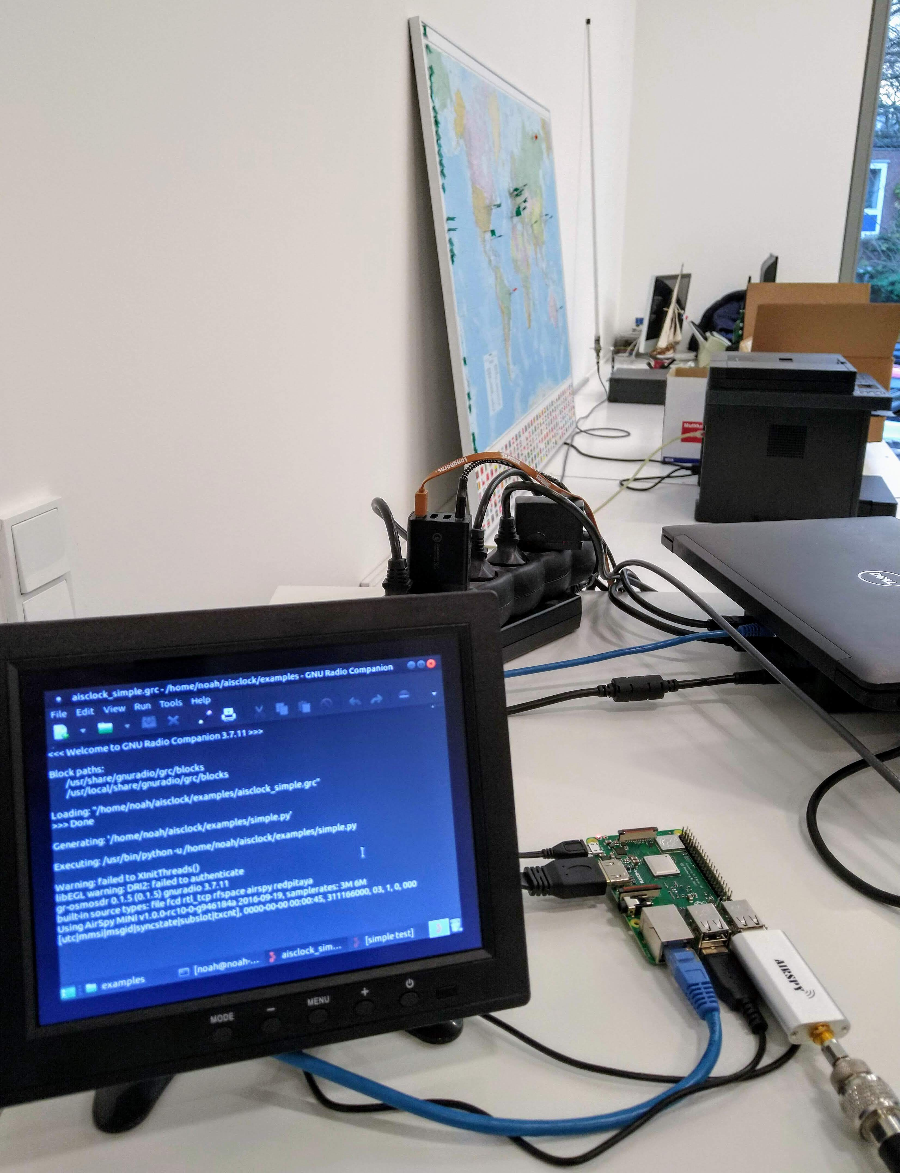
Vesseltracker VDES strategy
Still early days – we are interested in hearing what you think!
Still plenty of value in existing AIS – mission to provide high-quality worldwide data will continue
Clear opportunity in new VDES that we will pursue
R&D testing, first next-gen stations to be deployed 2020 in Baltic, Houston and more
Big questions:
  How to make best use of new VDES?
  Which features matter most to our clients and users?
Prototype VDES receiver

Slide 16


?
Q&A

Slide 17
Contacts
Antenna Network Manager - Vesseltracker.com
David Hewson
E David.Hewson@woodmac.com
Engineer
Dr. Noah Smith
E Noah.Smith@woodmac.com

