Slide 1
Technological initiatives / developments to enhance ferry safety
Safety @ Sea Conference: August 29, 2019
Marina Mandarin , Singapore.
www.ferrysafety.org

Slide 2
Technology & Ferry Safety
Outline of Presentation :
Who we are
Issues and Solutions
Human Error
Weather

Slide 3
Worldwide Ferry Safety Association: Who We Are
Mission: Save lives by reducing ferry fatalities
How:
Work in Realm of Data, Research, Information, Technology
Encouraging the next generation
Special Projects: Application of technologies
Notes:
SHOUT OUT TO HEIKE – MORAL AND INTELLICTUAL ASSISTANCE
What we do relates to the data we general
Findings from database about causes -- we commission research about

Slide 4
What We Do
Maintain database of ferry fatalities since 2000
Commission research on ferry systems & solutions
Sponsor international Student design competition for safe affordable ferry – going into 7th annual competition
Singapore Straits ferry 2017-18
Philippines Ferry 2018-2019
Convene Ferry Safety and Technology Conference – 6th annual : April 20-22, 2020 NYC
Notes:
Ferry Safety.org for more information
FOCUS ON TECHNOLOGY

Slide 5
Data analysis on Safety of Ferries
Causes and solutions
Cause % Solution
Human Error 75-92% Training
Weather 50% Actionable timely info
Overcrowding 29% Counting & enforcement
Collision 22% AIS
Other
Adds up to more than 100% because of multiple causes each accident
Notes:
YESTERDAY I SPOKE ABOUT TRAINING --

Slide 6
Sudden Hazardous Weather
Issues:
Detection – two levels at the macro and the very local
Macro – Broad weather patterns detected by satellites – but currently dearth of equatorial region by big satellites
Solution : Nanosatellites (shoebox size) Multiple nanosatellites for each rocket launch and each nano can have specific sensors
Very local --
Notes:
SINGAPORE STRAITS DON’T HAVE WEATHER PROBLEM CAN SEE WHAT IS HAPPENING ON ROUTE

Slide 7
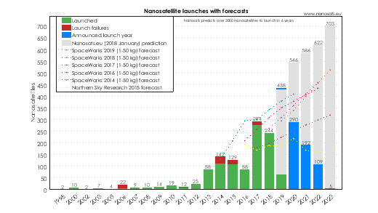
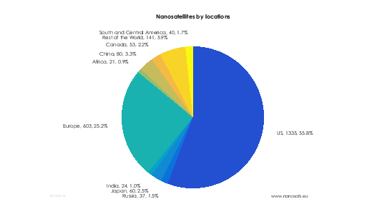
Nano-satellites
3kg – 10 kg in weight; shoe-box sized
Info at: https://www.nanosats.eu
Courtesy: Karsten Ingermann Pedersen / aerialmarine

Slide 8
Sudden hazardous weather at local level
Problem – weather alerts for ‘big storm in next 7 hours’ not as actionable as in next hour or two.
Technology Solution – Automatic weather monitors on landings and on vessels. Data is transmitted to terminals – but also analyzed to develop predictive algorithms.
Washington State Ferries has on ferries.
But they cost in the thousands
New solution low cost weather monitors – inexpensive sensors; raspberry pi computing power – inexpensive; open source programs; 3D printed case; few hundred dollars; one week plus repairs simple.
Notes:
Being developed at the University at Albany by colleagues; analogous low

Slide 9
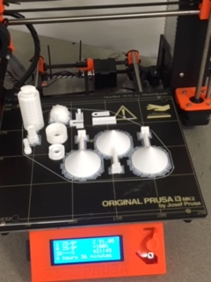
Low cost weather monitors & 3-D printers
3-D printing specimen
Low cost weather monitors
Courtesy: Berg George & Catherine Lawson/ University of Albany, USA

Slide 10
Why Focus on Technology ?
Technology :
Causes social change
Influences regulations & enforcement
Influences policies , practices (including safety culture) because :
Technology can make things happen, even
with minimal resources.

Slide 11
Thank you!
Captain Nurur Rahman AFNI , MAIMS
Worldwide Ferry Safety Association
www.ferrysafety.org
Please plan to attend:
Ferry Safety & Technology Conference
April 20-22, 2020 : New York City, USA

