Slide 1
AFISH: Using 3D Printing for Low-Cost Automated Weather Monitors for Ferries
TRB 1st International Conference on 3D Printing for Transportation
November 21, 2019
Dr. Roberta Weisbrod, Worldwide Ferry Safety Association
Dr. George Berg, University at Albany, SUNY

Slide 2
Outline
3D Printed Weather Monitors for Ferries
Why do we need them?
How do we create them?
When will we deploy them?

Slide 3
Why are local low cost automated weather monitors needed for ferry transport?
National Weather Service weather predictions can predict large scale events and their likelihood to occur in a multi-hour period of time.
But they are not precise as to place or time.
So for ferry operators the information is often not actionable.
What to do?

Slide 4
Automated weather monitors provide precise route weather for ferry operators
Washington State Ferries
Outfits five of their ferries with automatic ferry weather monitors
The information goes to NOAA office at the University of Washington and they post findings in under 20 min.
It is then available to all Puget Sound users

Slide 5
Ferry weather visualization
http://i90.atmos.washington.edu/ferry/Ferryjs/mainframe1.htm

Slide 6
Ferry weather visualization
Notes:
Did this berore I saw what Roberta did. ☺
Screenshot from last Friday (11/15/19)

Slide 7
Why not duplicate the WSF system?
Washington State Ferry weather monitors were obtained commercially.
About $10,000 each.
Commercial cost of repair likely to be high as well.
Newer models have far lower cost.
But ease of customization and repair required.
NOAA with USAID support developed low cost automatic weather monitors for farmers in developing world.

Slide 8
3DPrinted Automated Weather Systems - PAWS
Acknowledgements
Dr. Kelly Sponberg (NOAA, UCAR) inventor
Dr. Martin Steinson (NOAA, UCAR) developer
Sezin Tokar (Senior Hydrometeorological Hazard Advisor, USAID) implementer
Notes:
Kelly Sponberg an inspiring inventive warm hearted person is deceased

Slide 9
PAWS 3D printed weather monitor
A PAWS weather monitor in the field.

Slide 10
So WFSA and UAlbany decided to create low-cost weather monitors for ferries
Low cost for developing world
> 90% of ferry fatalities in developing world.
> 50% sudden hazardous weather related.
Fatalities high in weather cauldron of Indo-Pacific.
For developed world
Get actionable weather information.
Notes:
Developed world – predications – “line of severe storms some time in next 7-8 hours, somewhere in region

Slide 11
Why UAlbany?
Dr. George Berg –
Faculty at The University at Albany, SUNY (UAlbany).
Computer Scientist in the University’s College of Emergency Preparedness, Homeland Security, and Cybersecurity.
Expertise in
IoT computer systems,
Data analysis/machine learning, &
In design for 3D printed cyber-physical systems.

Slide 12
Why UAlbany?
Dr. Catherine Lawson:
Director, Albany Visualization and Infomatics Lab (AVAIL)
With Dr. Feng Chen, Adil Amil, and Aparna Joshi Developed techniques for eﬃciently detecting rapid weather change events and analyzing their impacts on the traﬃc ﬂow characteristics of a highway network – NYS Thruway.
Used archived raw weather information from a sensor network of ten weather stations.

Slide 13
Why U@Albany?
Dr. Eric Stern
Professor at the College of Emergency Preparedness, Homeland Security, and Cyber-Security
Expertise in sense-making and decision-making with regard to emergencies and crises.
Previous research on
extreme weather events
user ergonomics and crowdsourced data for public safety situational awareness.
Decade long engagement with government (U.S. Coast Guard) in the area of information sharing and interagency coordination for maritime security and safety.

Slide 14
Why Worldwide Ferry Safety Association?
Dr. Roberta Weisbrod
Former Chair of TRB Ferry Committee
Executive Director, WFSA
Compiles ferry safety data
Commissions research – including on weather
Sponsors Design Competition– different parts of world
Convenes Ferry Safety & Technology Conference
Network of international ferry operators, naval architects, transportation service providers, etc.

Slide 15
Introducing AFISH - low cost weather monitors
AFISH – Actionable Ferry Information System Hub
AFISH is an architecture for producing low cost weather monitors meant for a variety of maritime environments.

Slide 16
Elements of AFISH Weather Monitors
AFISH Weather Monitors
How:
3 D printed components
Cases and housings
Anemometers and wind vanes
Inexpensive components
Commodity sensors
Raspberry Pi computers
Metal and/or Plastic structural components
Open source hardware and software
What:
Low cost
Flexible/- Easily customized
Sustainable/- Readily repaired

Slide 17
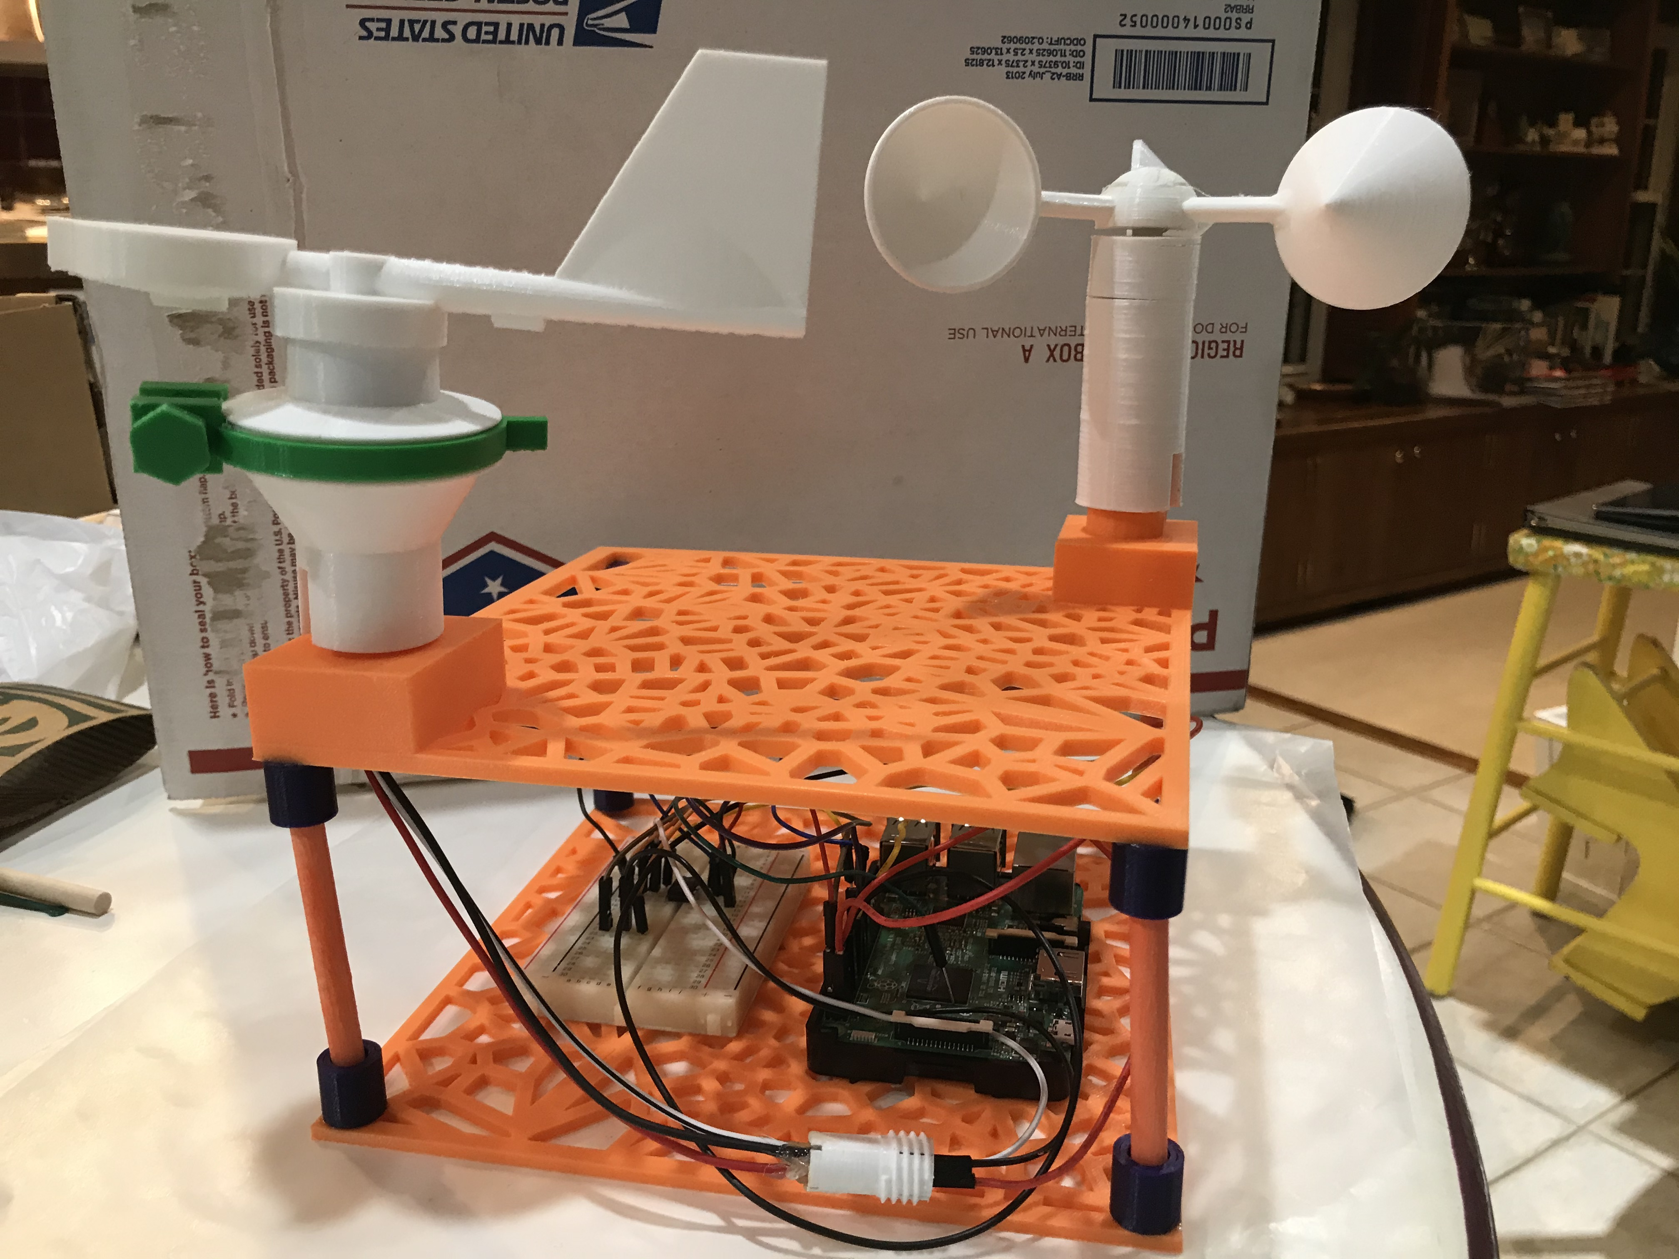
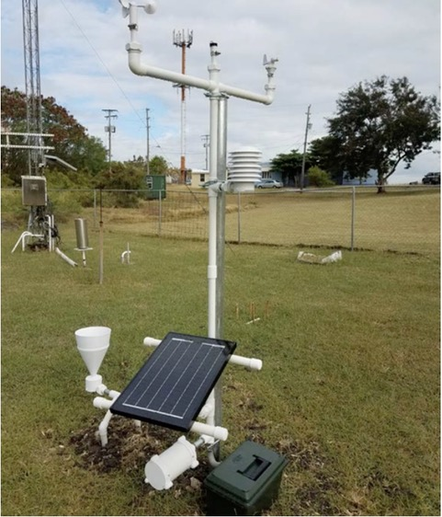
How are AFISH weather monitors made?
Notes:
Size of the casing in the C image is 9” on a side. In the L&C images, on left is wind vane on right is anemometer.

Slide 18
Overall plan
Monitors for ferries
Staten Island ferry
Hornblower ferry
Archipelago Ferries in Philippines
Naval architect lined up to direct how/where monitors to be placed.
John Waterhouse EBDG
On our board
Seattle based
Knows WSF staff so can understand placement
Consults for NYC DOT

Slide 19
Revised plan
Ferry Monitors at Landings first
Ferry NYC –
Hornblower made request for monitors at landings
The state of weather predictions are not currently actionable for ferry operators.

Slide 20
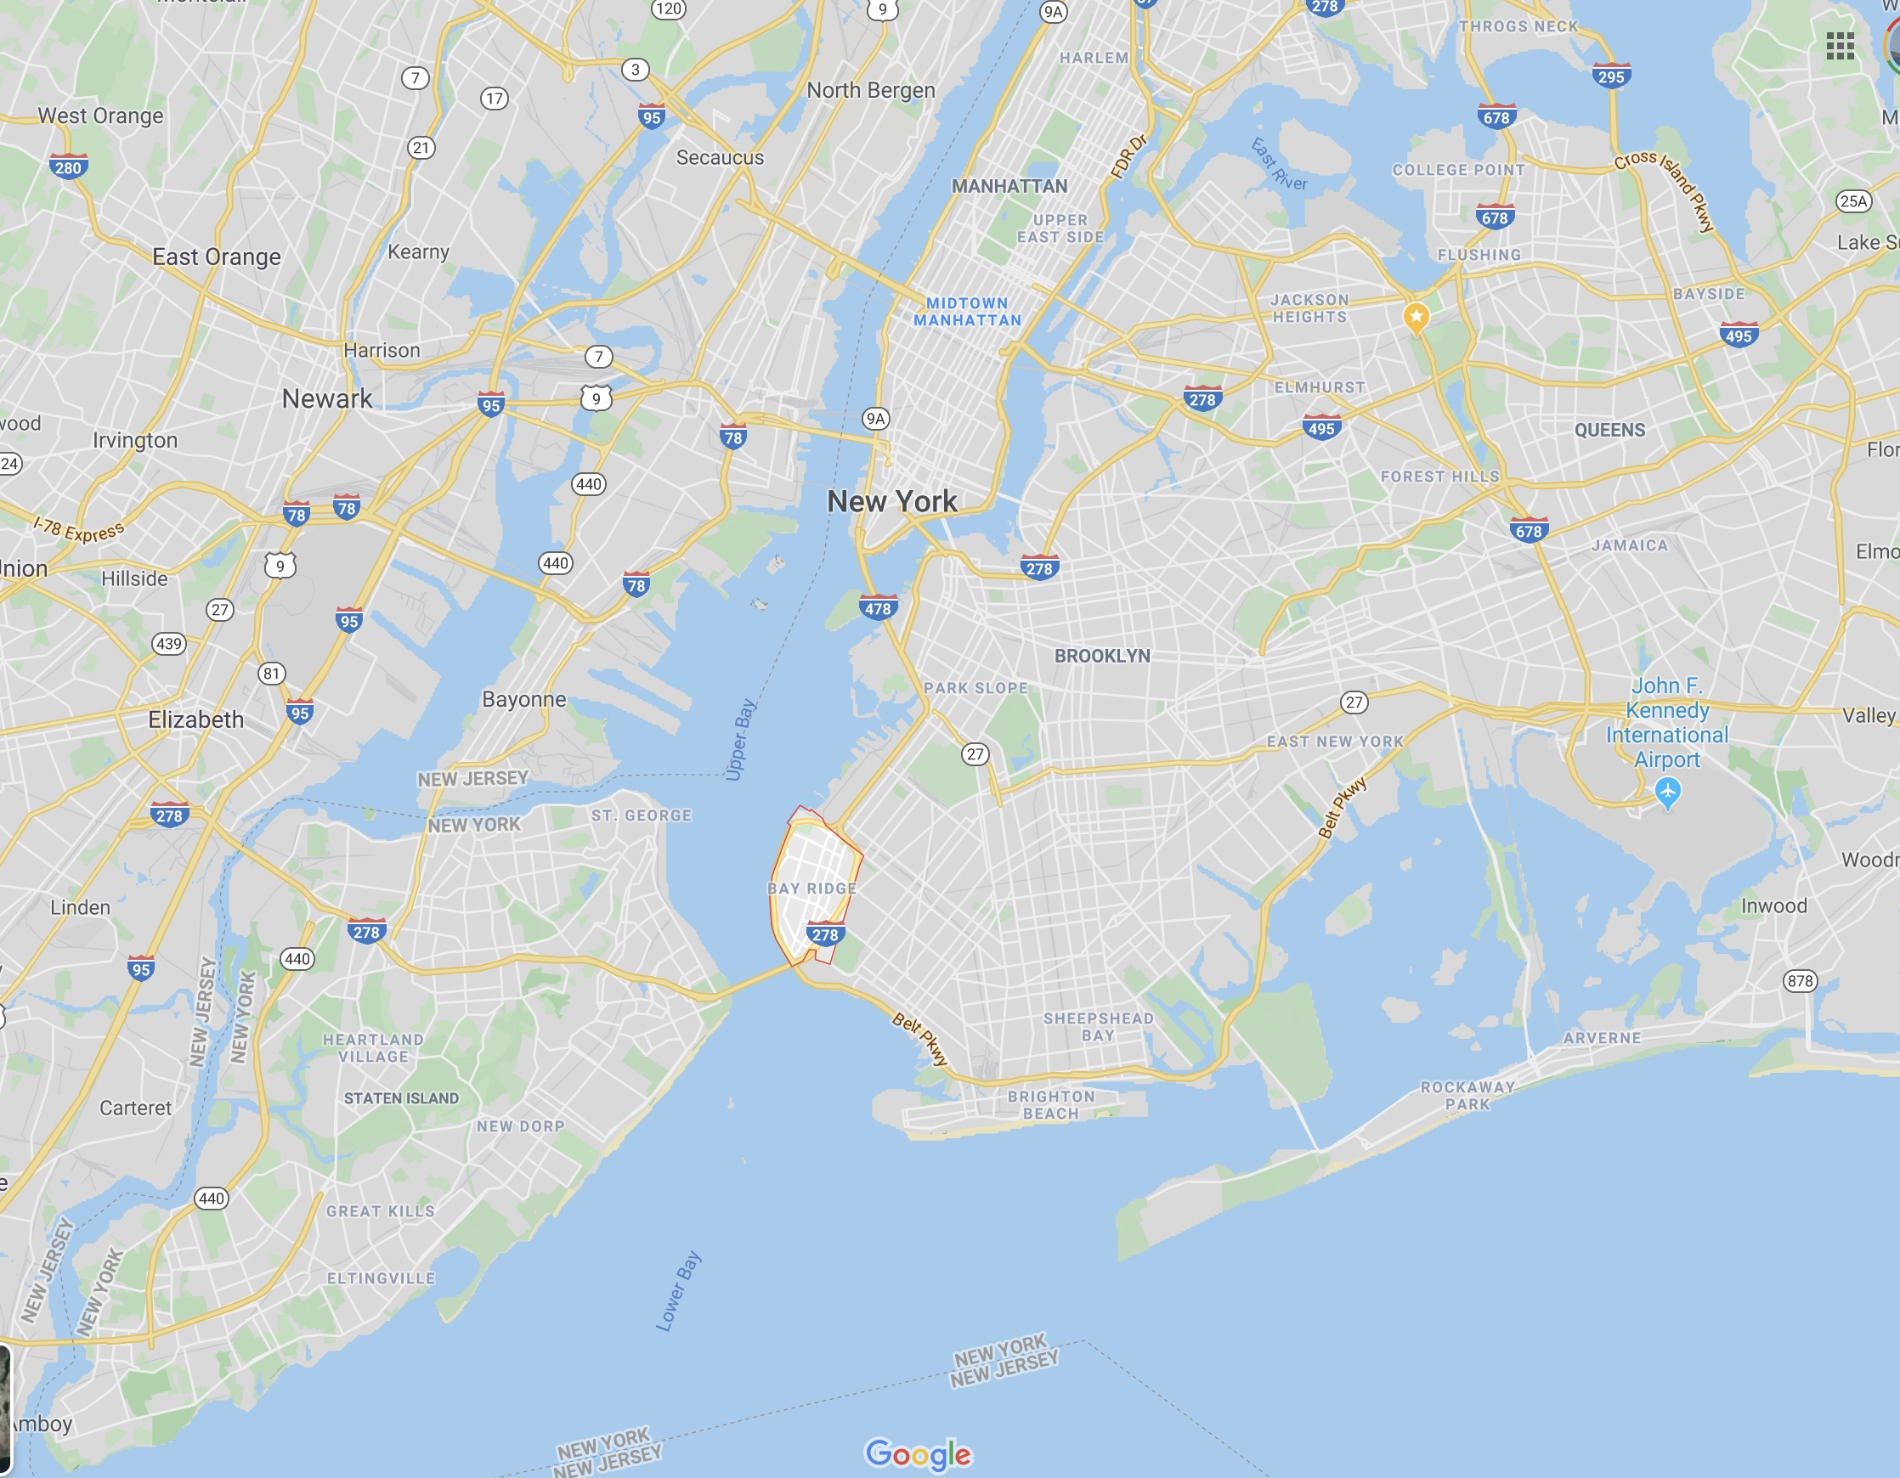
Siting – Bay Ridge, Brooklyn
X
Notes:
It will be attached to the breasting dolphin.

Slide 21
Siting – Bay Ridge, Brooklyn
Notes:
It will be attached to the breasting dolphin.

Slide 22
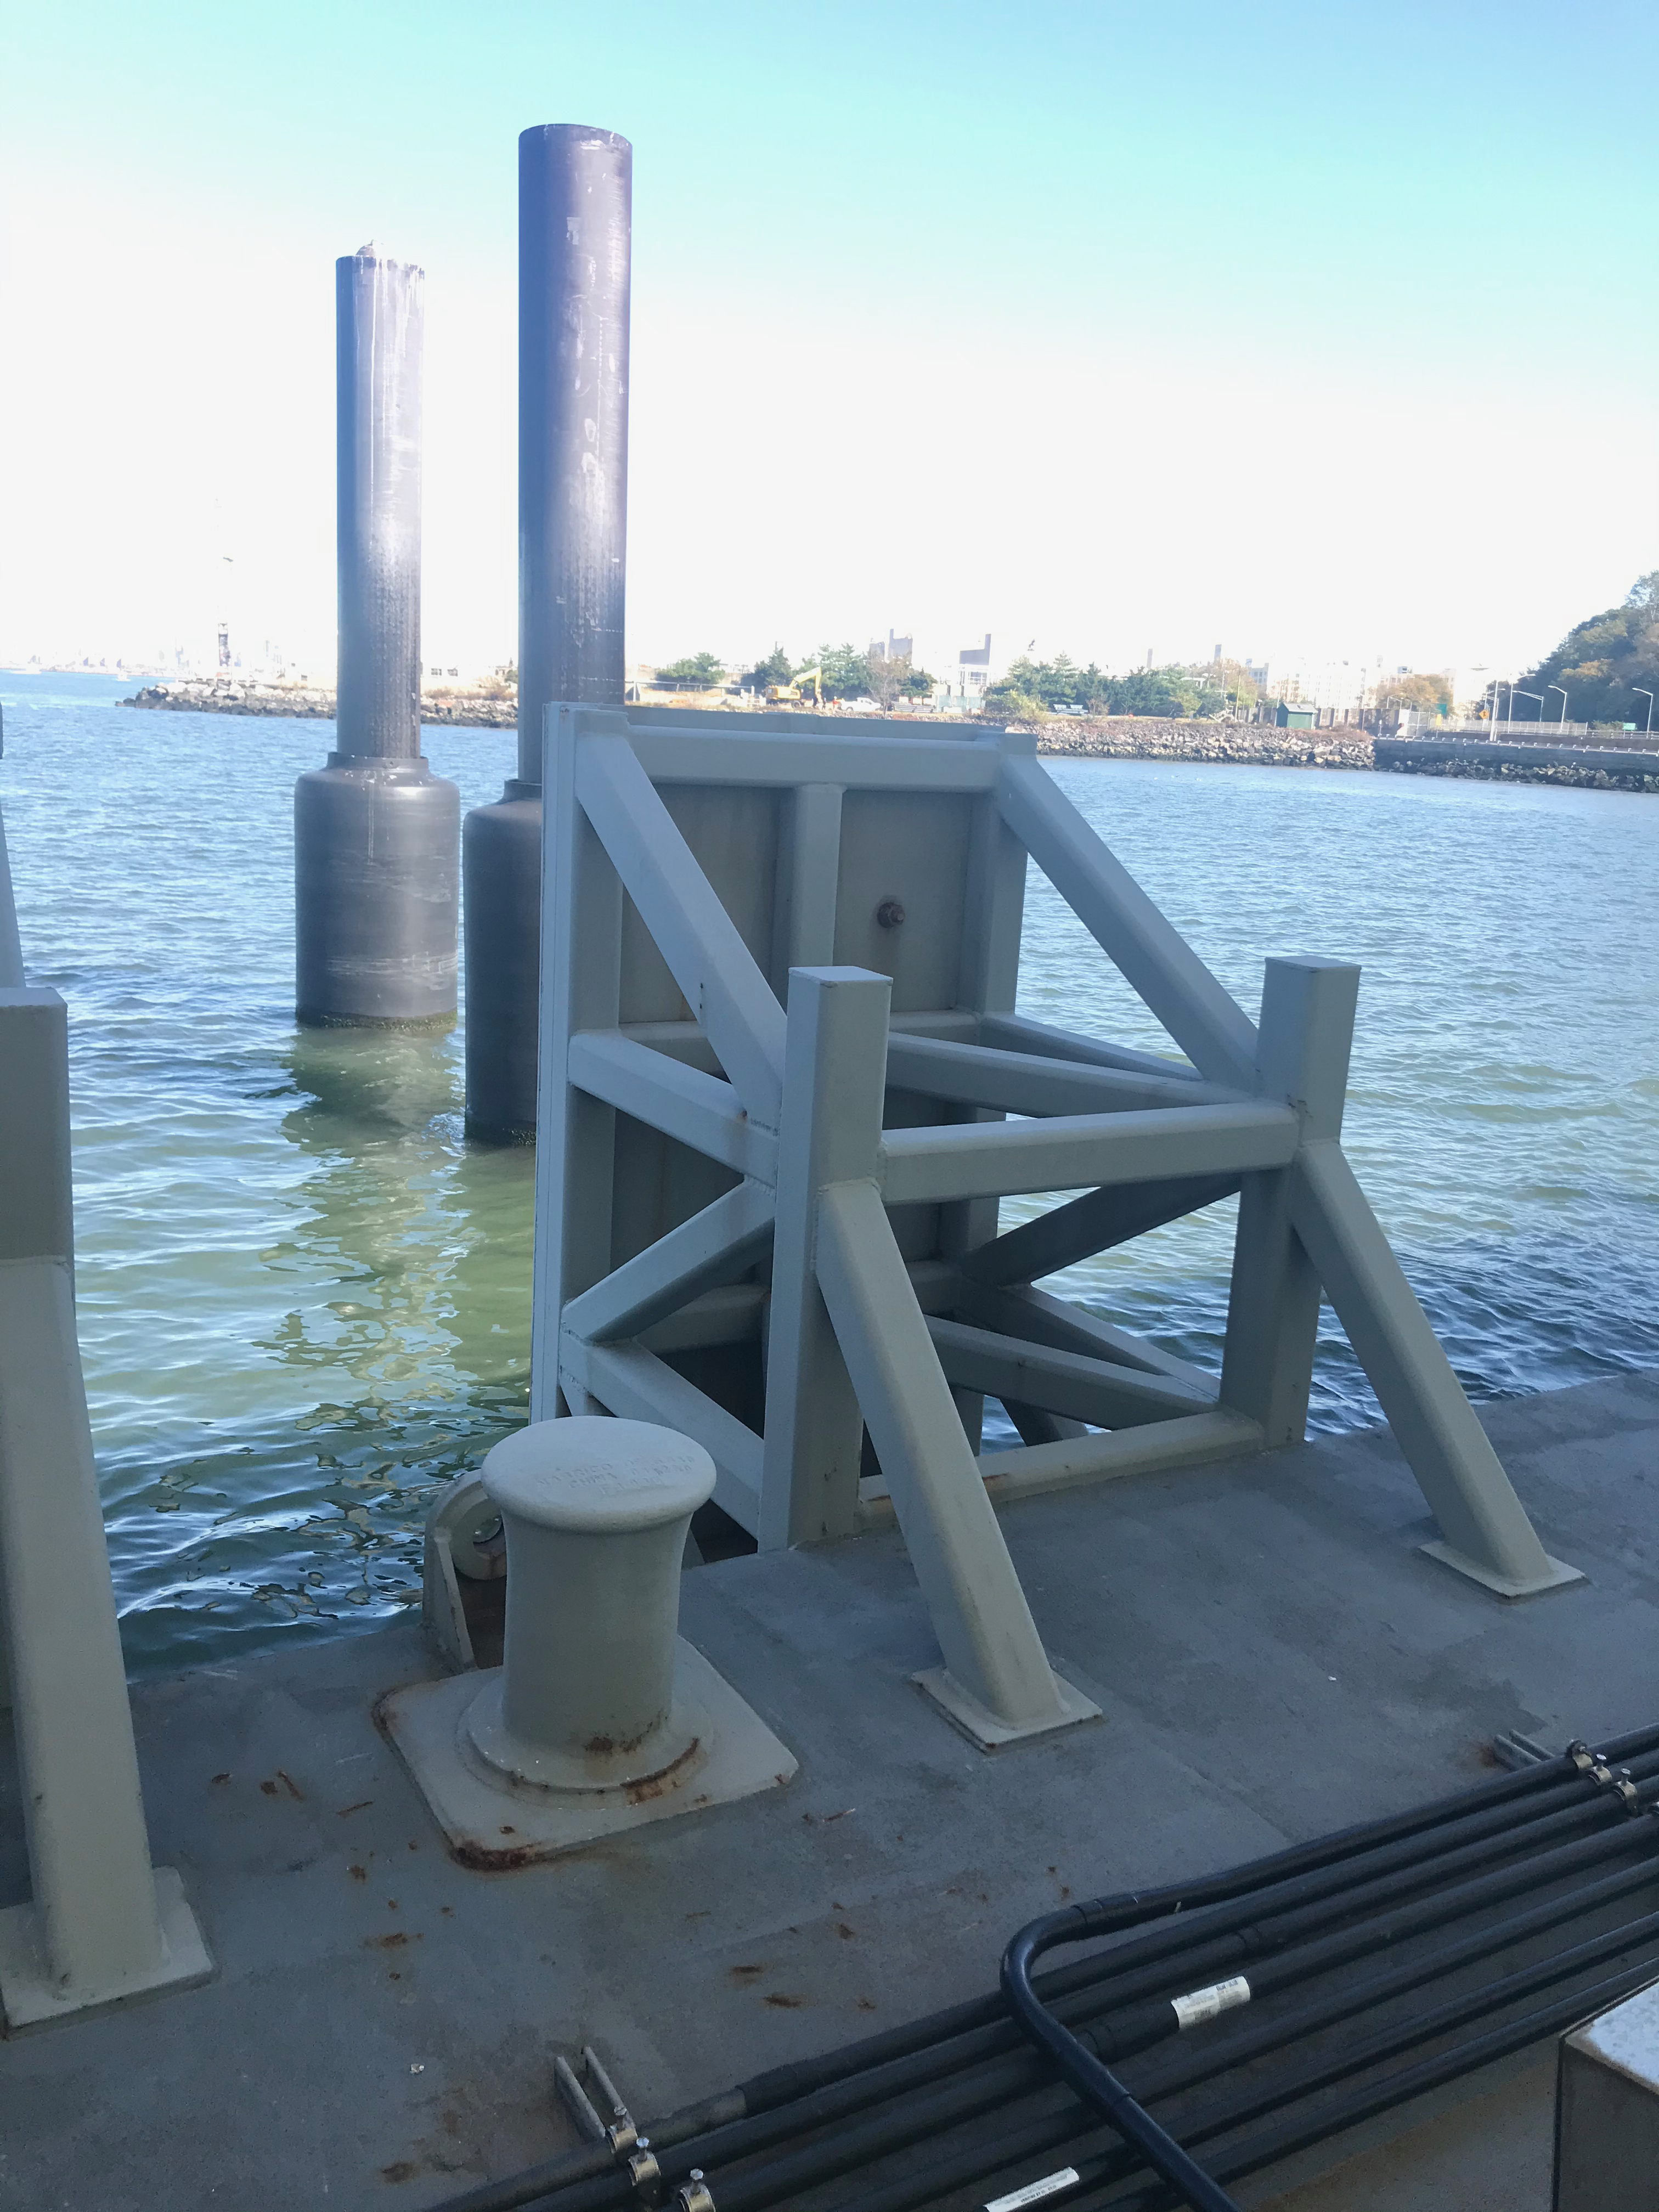
Dockside – Landing AFISH
We are creating a variation of AFISH for this
Landing AFISH
Landing AFISH is being tailored to the landings:
Environment
Power
Communications
Mounting
Notes:
It will be attached to the breasting dolphin.

Slide 23
Flow of information
The data from Landing AFISH will be securely sent to a central data base server.
From there information can be sent/analyzed as needed.
Group email to staff – re wind alerts
Information to NYCEDC

Slide 24
Next Steps
Installation visit to Bay Ridge
Winter 2019-2020
Currently aiming for the week of January 23, 2020.

Slide 25
Questions?
Give a sailor a fish, and he eats for a day. Give him AFISH and he’ll sail safer for life…
- Eric Stern

