Slide 1
Causes and Circumstances of Major Ferry Accidents, 2000-2014
Abigail Golden
Worldwide Ferry Safety Association
Presented January 11, 2015 at the Transportation Research Board Conference
Workshop on Ferry and Passenger Boat Safety

Slide 2
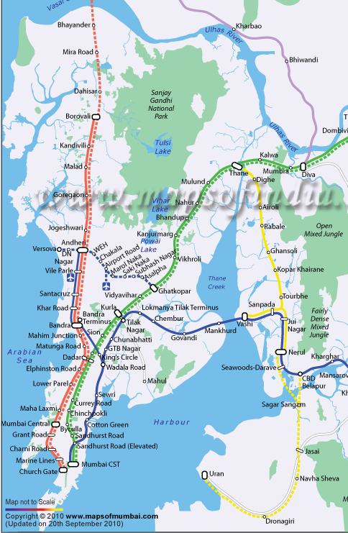
Why Study Ferries Globally?
Primary mode of transport for many in the developing world
Potential to avoid and reduce congestion and emissions
Rapidly growing cities are running out of space
Notes:
Example: Mumbai’s rail system is the most overcrowded in the world—traffic has increased sixfold in the past 40 years while capacity has only doubled. It currently has 7.5 million riders a day and there are 20 to 25 accidents per day, about half of which are fatal. Mumbai’s public transport needs major expansion, but the city is just too dense for new lines to be built, and it’s on a peninsula with the city center at the very tip so it can’t just expand outward. One solution? Ferries running north-south along the coast, parallel to the rail lines.
Source: http://www.theguardian.com/world/2013/oct/29/india-mumbai-population-rail-accidents

Slide 3
Why Study Ferry Accidents?
Passengers won’t use ferries unless they feel safe
News reports are sparse, inaccurate, and uninformative
Across the board, we’re missing:
Where accidents occur the most
How many people die
Why accidents happen
Notes:
Example: Overcrowding, incomplete manifests, passenger death estimates that range over several hundreds

Slide 4
Methods
Local and global news reports
Cross-checked across multiple sources
Collected data on: number of dead and missing, time of day, weather, location, overcrowding, state of vessel, name of operator
25 data fields per accident
Goal: determine proximate and root causes of all accidents in the database
Notes:
As you can see, sources range from the Guardian to Ghana Today (in red). Each of our sources had its own bias as you can see with the Guardian headline, which made it important to collect information from multiple articles and news orgs where possible.

Slide 5
Results
163 accidents in 14 years
Over 17,000 deaths (conservative estimate) in 40 countries
95% of accidents occurred in developing countries
Four countries,10% of all countries, responsible for >50% of all accidents
Notes:
Note that all of the top 10% of countries are in Asia and Southeast Asia

Slide 6
Human Error
Some examples
Improper stowage of rolling cargo
Overcrowding
Misjudgment of weather conditions
What is human error?
Conservative vs. liberal parameters
Conservative estimate: 54% of total accidents and 67% of total fatalities caused by human error
Liberal estimate: 77% of total accidents and 87% of total fatalities caused by human error
Notes:
What about definition – conservative liberal etc
Errors of omission—forgetting to do something, or just leaving it out
Errors of commission—performing an act incorrectly
Sequence—right action, wrong order
Timing/rate—too fast or too slow
Example of the Acita 3—also severely overcrowded, but this is a very obvious example of human error

Slide 7
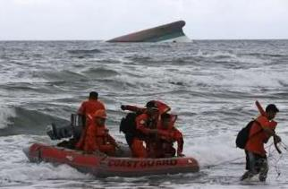
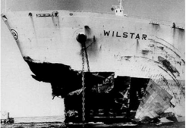
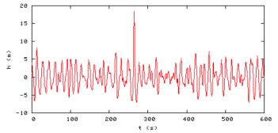
Weather
Implicated in more than 50% of accidents
Some threats:
Typhoons
Fog and low visibility
High waves/sea state
Swift currents
Rogue waves
Reuters/Romeo Ranoco
New York Times
Rosenthal 2008
Notes:
Image 1: Rescue workers heading toward shore, with the capsized Princess of the Stars in the background. The vessel had been allowed to sail even though Typhoon Fengshen had already made landfall, because it was considered to be a large enough vessel to stay afloat on its route, which was only on the storm’s periphery. However, Fengshen changed trajectory unexpectedly.
Image 2: Effect of a rogue wave on the Wilstar—entire hull is gone.
Graph: Central spike is the Draupner wave, first rogue wave captured on recording equipment. Occurred at the Draupner offshore drilling platform in 1995. Explain the rogue wave phenomenon and how much damage it can cause (Image 2).

Slide 8
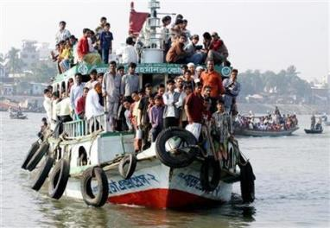
Overcrowding
Severe and rampant
Contributed to up to 43% of total accidents
Vessels have capacity limits, but more passengers mean more profits
Not usually fatal on its own— but makes vessels more vulnerable to other threats
Credit: Reuters/Rafiqur Rahman
Notes:
Ferry heading into Dhaka on the Buriganga River—not an accident, but used by Reuters to illustrate overcrowding. http://www.reuters.com/article/2008/02/28/us-bangladesh-ferry-idUSDHA17221920080228

Slide 9
Next Steps
Continued monitoring of accidents as they occur, to capture long term trends
Research and analyze local and countrywide ferry systems
Current and past projects include: Philippines, Tanzania, the Amazon, Indonesia, Bangladesh
Worldwide Ferry Safety Association programs focus on:
Vessel design
Training
Weather
Empowering passengers
Notes:
Research ferry systems – WFSA reports on Philippines, Tanzania/Zanzibar, Amazon, Guixhou China (check spelling), and by then Indonesia and Bangladesh and perhaps South Pacific island

Slide 10
Learn More
Our work is completely open access: http://www.ferrysafety.org/news.htm
Play with our data!
2015 Ferry Safety and Technology conference in New York City (visit ferrysafetyconference.squarespace.com)
Contact:
Abigail Golden
Worldwide Ferry Safety Association
abigolden@gmail.com
@saferferries

